Slide 1
Developing Delivery Capability at MPA through Conversation Tim Banfield

Slide 2
Growing Project Delivery Capability in Government
Tim Banfield
Director, Strategy
Major Projects Authority
June 2015

Slide 3
Right projects, Done right

Slide 4
I will cover:
The Major Projects Authority:
The Project Delivery challenge;
Capability and Capacity:
Developing the profession;
Supporting the profession.
Building the profession;
Growing leadership capability;
Communities;
Strategic prioritisation and Front-end loading.
Notes:
and NAO report ‘Assurance of High Risk Projects’ June 2010

Slide 5
The Major Projects Authority
Two thirds of Government projects failed pre 2010;
The Major Projects Review 2010 highlighted:
A lack of central oversight.
No understanding of the scale of the undertaking – the number, size or complexity of Government projects.
Little accountability or responsibility for underperformance.
Little collaboration between the departments and the centre.
Lack of effective senior project leadership capability.
Previous performance no longer acceptable.
The Prime Minister’s mandate means that MPA now has much greater control, influence and oversight of major projects
Notes:
Prime Minister’s mandate January 2011
Assure and scrutinise Government Major Projects Portfolio
Intervene in failing projects
Build capability in departments
Publish Annual Report of Major Projects

Slide 6
MPA Priorities
Assurance
Support
Capability/Capacity to Deliver
Principles/Ways of Working
Notes:
230 Assurance Reviews / 30 Follow-up Reviews in the last 12 months
Half of the projects faced the most significant challenges showed improved delivery confidence

Slide 7
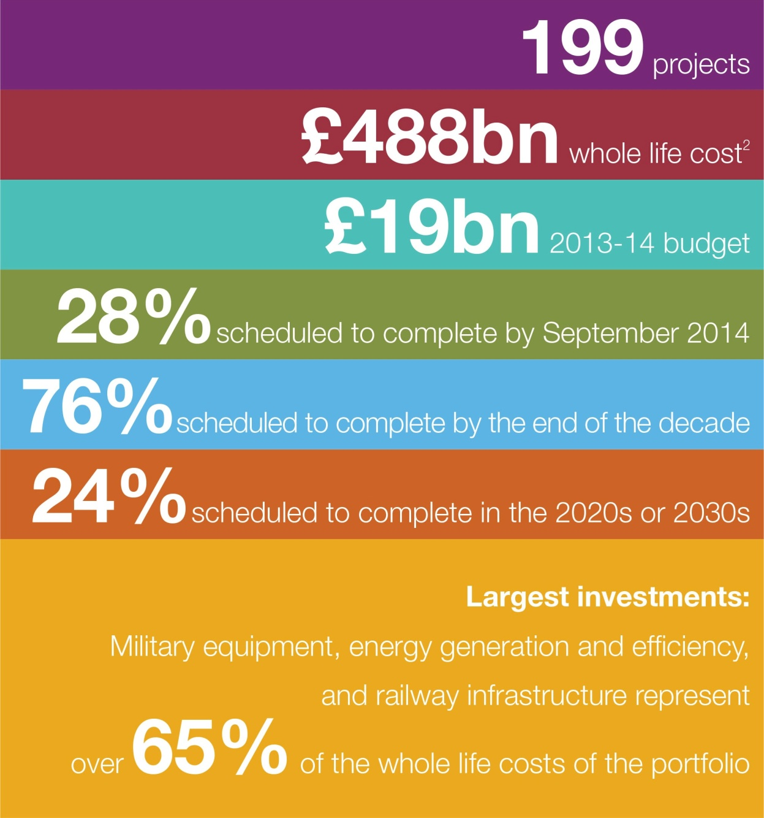
GMPP in numbers
Notes:
3 departments make up ~ 65% WLC:
Department of Energy and Climate Change
Department for Transport
Ministry of Defence
Reflecting the high capital costs of energy and transport infrastructure and military equipment

Slide 8
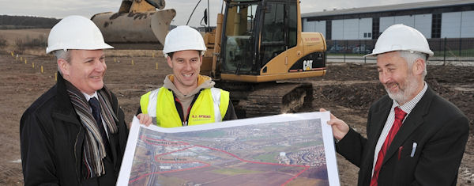
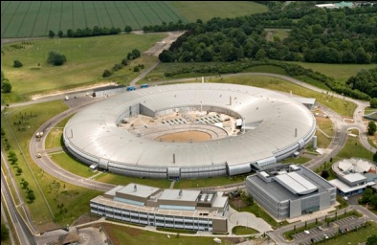
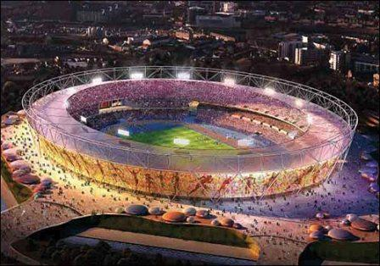
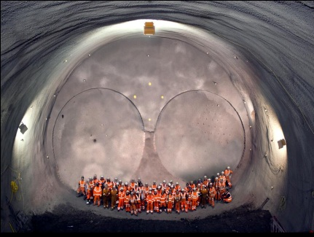
Major projects are more diverse than would first appear
Transformation: change, people and IT
Capital eqpt:
capability, performance and politics
NHS Change Model
A380
HMS Dragon (T45)
“This is not a ship”
Enterprise: business growth
Big science: science, infrastructure and politics
Aire Valley Leeds Enterprise Zone
Elon Musk, SpaceX
Diamond Light Source, Oxon
Doesn’t happen like this anymore
Mega-events: sports, culture and politics
Megaprojects:
physical infrastructure, concrete, IT and politics
Crossrail
The Stadium, Queen Elizabeth Olympic Park
Energy:
Social programmes
mostly politics?
Wind farm
Sellafield nuclear plant
obesity
education

Slide 9
Distribution of projects by DCA
A spread of confidence in delivery, with the highest proportions of projects rated amber and amber/green in both years
An increase in the percentage of projects rated amber/red and a decrease in the percentage rated green
Notes:
Green - Successful delivery of the project on time, budget and quality appears highly likely and there are no major outstanding issues that at this stage appear to threaten delivery significantly
Amber/green - Successful delivery appears probable; however, constant attention will be needed to ensure risks do not materialise into major issues threatening delivery
Amber - Successful delivery appears feasible but significant issues already exist, require management attention. These appear resolvable at this stage and, if addressed promptly, should not present a cost/schedule overrun
Amber/red - Successful delivery of the project is in doubt, with major risks or issues apparent in a number of key areas. Urgent action is needed to ensure these are addressed, and whether resolution is feasible
Red - Successful delivery of the project appears to be unachievable. There are major issues with project definition, schedule, budget, quality and/or benefits delivery, which at this stage do not appear to be manageable or resolvable. The project may need re-scoping and/or its overall viability reassessed

Slide 10
Improvement in DCA of 2012/13’s amber/red - red projects
Half of the projects faced the most significant challenges show improved delivery confidence

Slide 11
We are developing capability/capacity at several levels
1. INDIVIDUAL - build competence, capability and confidence.
2. PROJECT TEAM – individual competence is critical but a complex project will not achieve success without a high-performance team. Mix of hard and soft elements
3. DEPARTMENTS – create the environment for success
4. CROSS GOVERNMENT- provide professional leadership, advocacy and focus for learning and evolution

Slide 12
Why people matter
Source: PMI’ Pulse of the Profession: The High Cost of Low Performance, 2014,

Slide 13
Developing the profession: work streams (1)
Leadership & Governance – Getting the right leadership in place and enabling them to set strategy, lead and implement change for the Profession within departments and across government.
Structure – Defining the Profession and Professional via common definitions, job families, roles, expectations and a clear career path from entry level through to senior project leadership.
Fast Stream & Fast Track Apprenticeships – Designing and promoting new graduate and school leaver schemes which bring fresh talent to the Profession.
Capability Assessment – Assessing the capability of the Profession across government departments, and supporting the implementation of recommendations.
Stakeholder engagement – Develop active and valued communities of Professionals for networking, best practice and knowledge sharing
Pay & Reward – Developing a pay and reward strategy that is competitive in the market to support getting the right people on the right jobs at the right price.

Slide 14
Developing the profession: work streams (2)
Talent Management – Building knowledge of our Professionals and identifying the highest potential individuals to ensure the right people are working on the right projects with strong pipelines for succession.
Curriculum – Developing a project delivery curriculum and commission learning products from CSL which support development needs of Professionals and the Project Delivery community.
Brokering – Building a brokering service that facilitates getting the right resource on the right project at the right time.
Knowledge – Developing knowledge sharing and management to support continuous improvement, sharing of best practices and knowledge within and between government departments.
Pay & Reward – Developing a pay and reward strategy that is competitive in the market to support getting the right people on the right jobs at the right price.

Slide 15
Services supporting the profession: work streams
Major Projects Leadership Academy – Create a world class cadre of project professionals who are properly trained to lead each of our major projects.
Project Leaders Programme – Build from MPLA to increase project leadership capability for priority projects at the tier below GMPP
Accountability and responsibility - Ensure we have the right SROs and project directors in place who have the autonomy and flexibility to deliver their projects
Data analysis and insight – Underpin evidence based decision-making on project initiation, design and delivery.
Research – Generate new insights and understanding by learning from experience to enable better informed judgements on project initiation, design and delivery.
External engagement and thought leadership – Share our understanding and draw on the best knowledge available in academia, commercially and overseas.

Slide 16
The Project Delivery Profession will:
attract and retain the best individuals: providing a rewarding career, supporting continuous professional development and shaping a community to feel part of and inspired by;
provide cost effective, skilled, flexible project delivery leaders for departments: enabling effective delivery of policy (reducing the reliance on CCL); and
improve delivery of (large through to small) project outcomes for the benefit of our society.
Building our capability and growing our talent, so we excel in project delivery for public benefit
Notes:
What is our vision?

Slide 17
The Project Delivery Profession is…
…the body of recognised experts and those who aspire to be experts who lead and support delivery of project outputs and outcomes for public benefit
Governance: strong, inclusive, effective. Underpinned by a code of practice, that sets standards (and a gateway) and protects members interests.
Structure: defined roles and capabilities, performed to the standards, with defined competencies for specific levels and roles.
Growing body of knowledge: from the pure academic through sharing of experience, a curriculum comprising generic courses through to hands on learning, qualifications – accredited or validated.
Communities of Practice: Networks promoting collaboration, sharing good practice, advice and support, informing strategies. Within and across departments and include private / commercial parties.
Notes:
What do we mean when we refer to the Project Delivery Profession?

Slide 18
Project Delivery Communities of Practice

Slide 19
How Communities will help
Project Delivery
Better Services
Business Knowledge
Better Products
SRO
Project Delivery Practioners
Professional Bodies
Other Communities
Customer Satisfaction
Lower Costs
Knowledge Database
Operational Efficiency
Community Participation
Experts
Best Practices
Higher Quality
Cross Fertilisation
Understanding Customers
Collective Intelligence
Social Events
Insights
Sharing Wisdom
Innovation
Forums
Knowledge Retention
Practitioner Efficiency
Decision Making
Blogs
Comments
Collaboration
Problem Solving
Improved Capabilities
Business Processes

Slide 20
Making good judgements
Front-End loading - The process used for managing the set-up of new projects is too simplistic given the costs and risks. In future:
Project initiation is undertaken rigorously, only the right projects are started;
Based on alignment with policy priorities, deliverability, benefits and risks, and with flexible delivery options.
Strategic prioritization – past tendency to over-commit portfolios. In future:
Make the right decisions based on a holistic understanding of resourcing, constraints, risk and interdependencies;
Identify underperforming projects early and intervene to turnaround, disaggregate or cancel these projects.
Notes:
MPA experience points to a number of common symptoms stemming from poor initial planning:
Unfeasible delivery models
Lack of clear delivery plans
Unachievable or over-optimistic implementation timetables.
An unclear vision for project success
Weak measures of success or failure
Unclear governance
Insufficient delivery capability
Poor understanding of dependencies

Slide 21
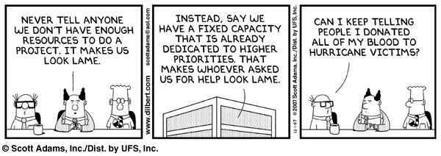

Slide 22
Strategic Prioritisation
What is the landscape (number, characteristics, status and level of aggregation of each project) of the department’s current projects portfolio?
How does the projects portfolio, and each individual project, align with and support the delivery of the department’s strategic objectives?
What is the through-life cost, funding, and resourcing profile of the department’s projects portfolio?
What are the constraints to delivering the department’s projects portfolio, and what are we doing to address these constraints?
What are the interdependencies within the department’s projects portfolio, and how are we managing the impact of these interdependencies?
What are the major risks against the department’s projects, at both the project and cumulative portfolio level, and how are we managing these risks?
What is the department’s future pipeline of projects, and how will those projects be integrated into the portfolio?
What is the department’s prioritisation of projects, and how have we prioritised these projects?
How effective is the existing governance structure for both individual projects and the portfolio as a whole, and what mechanisms exist for ongoing review and management of the portfolio?
Does the department have a culture that encourages openness about issues facing both individual projects and the portfolio as a whole, and action on the basis of any concerns?

Slide 24
Inherent challenges to good implementation planning ……
Political pressures
A challenging and intensive process
A rush to set up projects driven by political pressure – e.g. Ministerial announcements
Difficulty of creating a ‘safe space’ for conversations
Limited experience and capability in implementation
Complex problems requiring bespoke solutions
Systemic incentives to be optimistic about cost and delivery
Lack of spare capacity in departments
Lack of a clear description of the problem to be solved and/or the needs of users
Lack of clarity of agenda: clear strategic goals & options are poorly defined.
Departments underestimate required time and resource
Lack of experience of alternative delivery models, and staff embedded in existing delivery models
Poor project
initiation
Threatening conversations about control, and organisational change
Lack of implementation expertise while ‘policy’ solutions are developed
The psychological urge to jump to solutions
Entrenched existing views
Absence of project leadership participation at the early stages of project design
Promotion of ‘pet projects’
Pressure to maintain the status quo
Absence of policy understanding in detailed project set-up
Management impatience with a lengthy, iterative process
Internal vested interests
Departmental silos
The tendency to fix solutions too early
24
Notes:
The root causes

Slide 25
Tim Banfield
Director, Strategy
Major Projects Authority
e-mail: tim.banfield@cabinetoffice.gov.uk
Telephone: +44 20 72716912
Mobile: +44 7779 143 761

